Slide 1
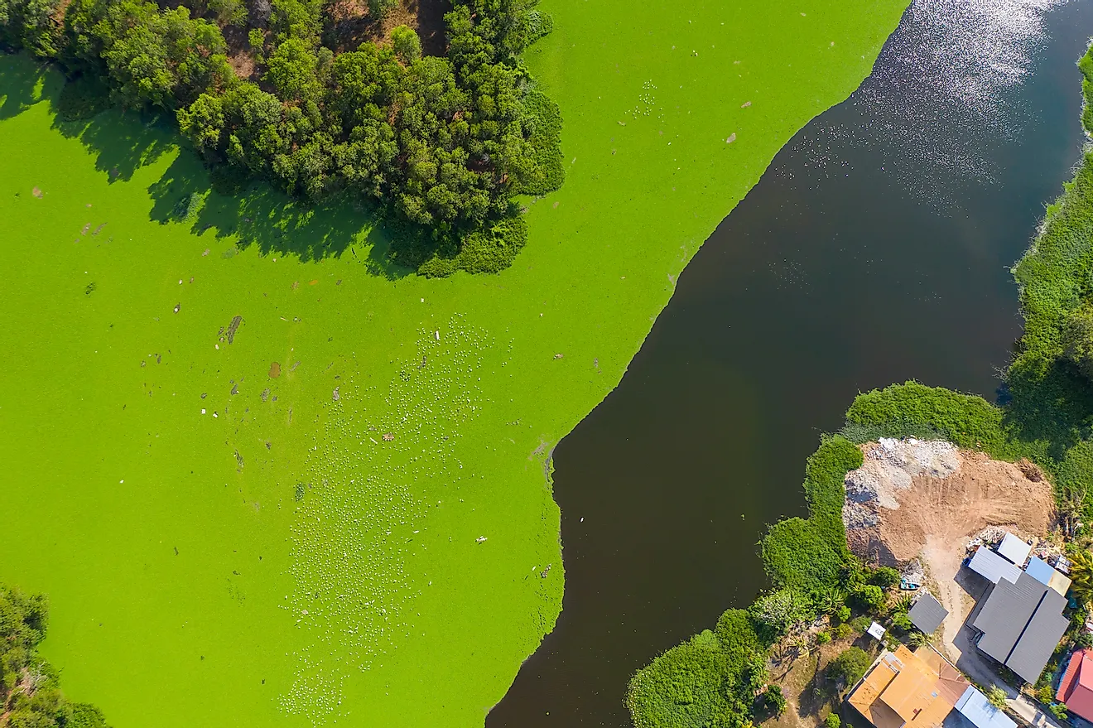
EFFECTS OF EUTROPHICATION ON MICRO-ALGAE TOXICITY
GROUP 19

Slide 2
OUTLINE
INTRODUCTION
EUTROPHICATION
MICROALGAE
TOXINS OF MICROALGAE
PROCESS OF EUTROPHICATION
EFFECTS OF EUTROPHICATION ON MICROALGAE TOXICITY
MEASURES TO MITIGATE HARMFUL ALGAE BLOOMS
SUMMARY
REFERENCES

Slide 3
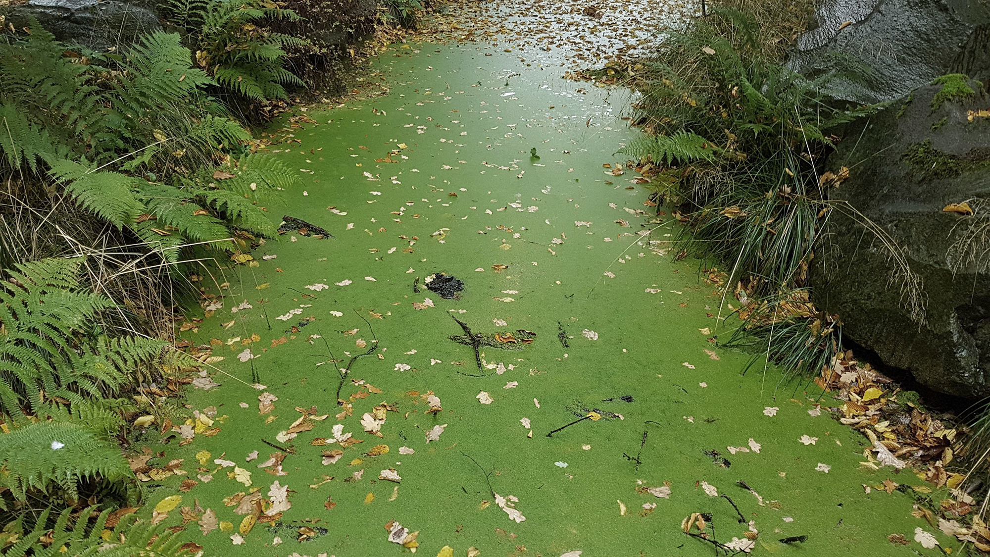
INTRODUCTION
Eutrophication is an increase in the rate of supply of inorganic and organic nutrients to an ecosystem, with significant increase globally over recent decades. Anthropogenic influences are the major causative factors having consequences such as harmful algal blooms (HABs),water poisoning events, often with far-reaching ecosystem and human health effects.

Slide 4
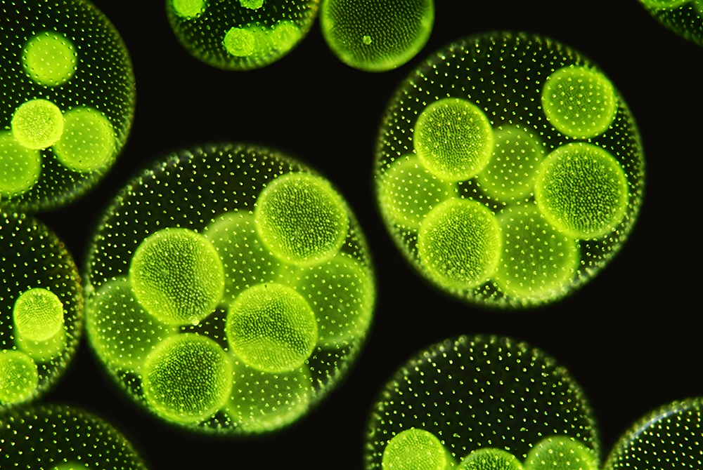
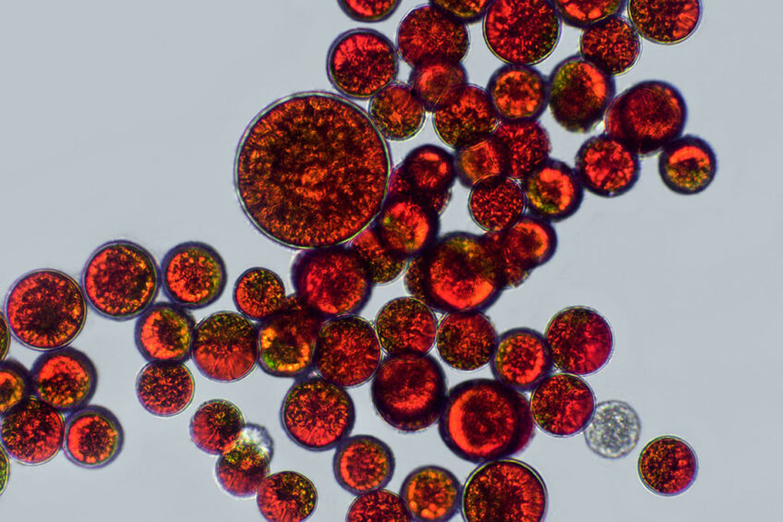
WHAT ARE MICROALGAE?
Microalgae are phyto-planktonic microorganisms that can proliferate under certain circumstances giving rise to spectacular coloration events (e.g. red tides). We speak about ‘Harmful Algal Blooms’ (HABs) when microalgae including dinoflagellates, diatoms, raphidophytes, and cyanobacteria induce oxygen depletion and release toxic compounds (phycotoxins).

Slide 5
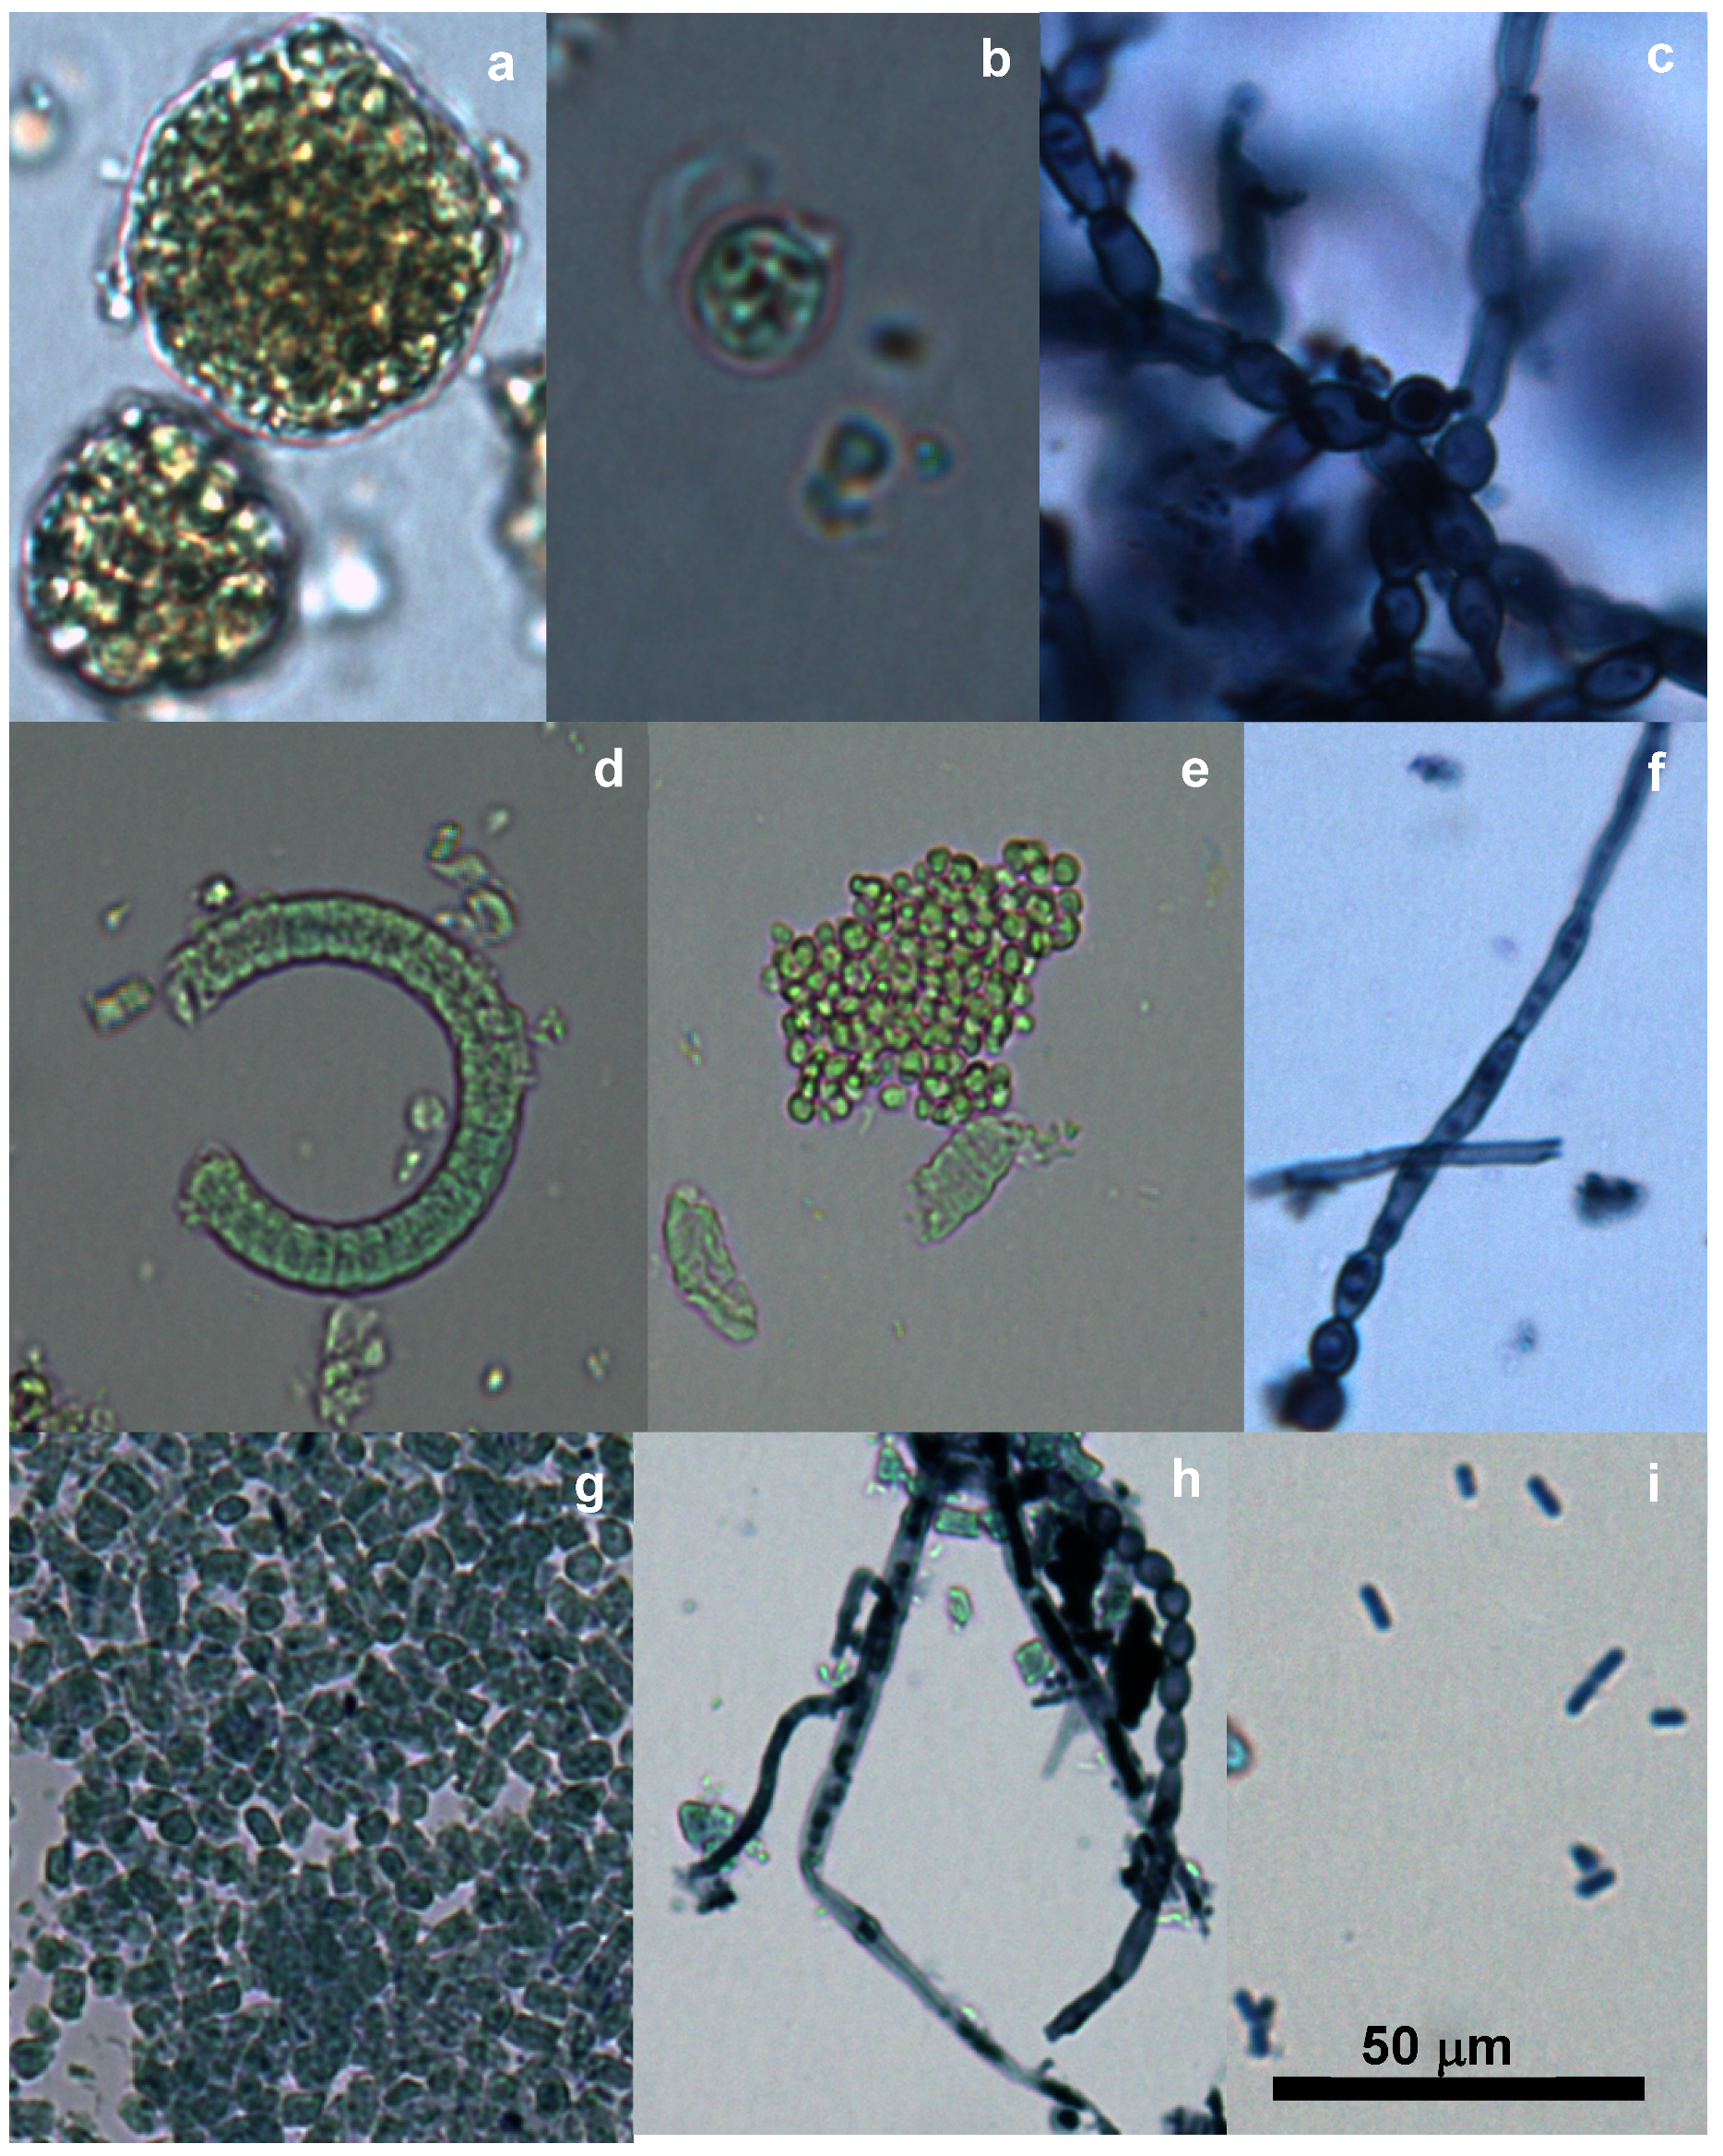
TOXINS OF MICRO-ALGAE
About sixty microalgae species have been identified as toxigenic, belonging primarily to dinoflagellates and diatoms. The toxins they can produce and their effects on humans are classified into many groups; diarrheic (DSP), paralytic (PSP), amnesic (ASP) and neurotoxic (NSP) toxins which make up only 2% of the compounds they contain. Microalgae blooms are a serious threat for the consumption of sea products, especially bivalve molluscs and fishes that bioaccumulate them through the trophic chain.

Slide 6
PROCESS OF EUTROPHICATION
Nutrient input
Algal growth
Algal bloom
Decomposition
Oxygen depletion
Ecological impact

Slide 7
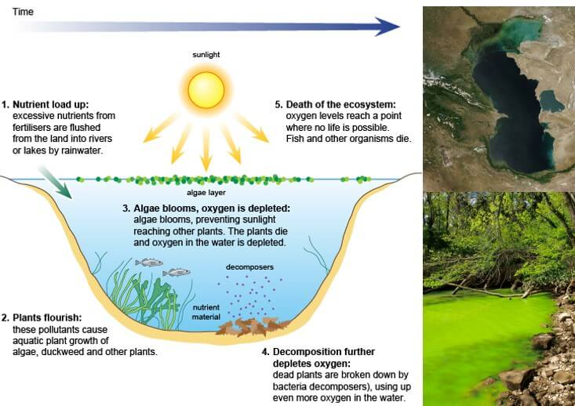
HOW EUTROPHICATION INCREASES TOXICITY OF MICRO-ALGAE

Slide 8
EFFECTS OF EUTROPHICATION ON MICROALGAE TOXICITY
Algal blooms and toxin production.
Shift in micro-algae community.
Harmful algal blooms (HABs)
Oxygen depletion.
Trophic transfer of toxins.
Economic impact.

Slide 9
MEASURES TO CONTROL/MITIGATE HABs
Reduce nutrient input
Wetland installation
Implement buffer zones
Improved waste water treatment
Sustainable agriculture
Policy and regulation
Research and innovation

Slide 10
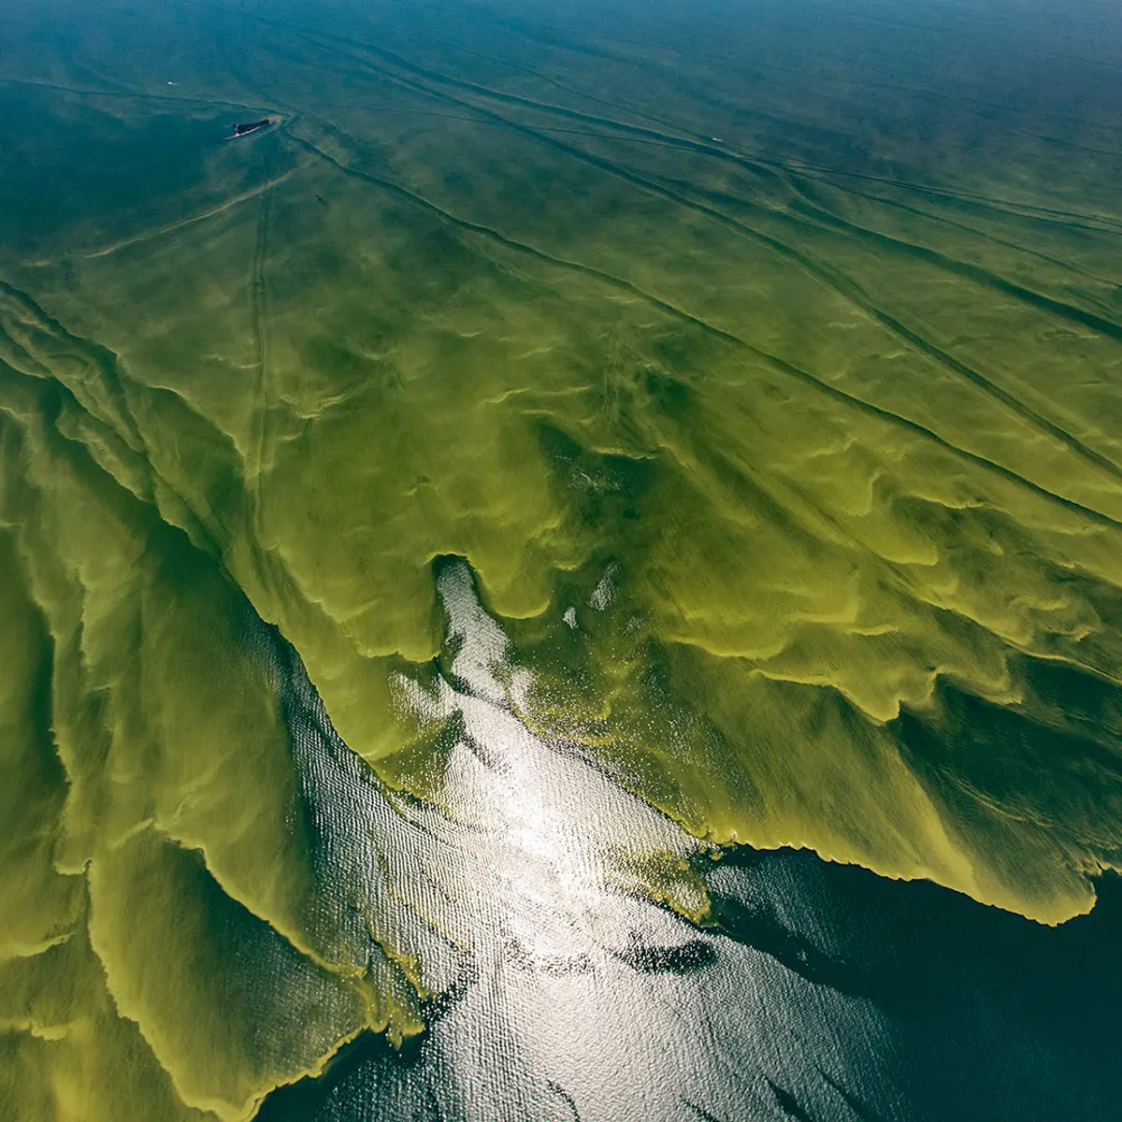
SUMMARY
The past decades have witnessed recurrent occurrences of microalgae blooms. The impact of human activities on this phenomenon which is likely to aggravate in the future is no longer questioned by the scientific community. There is a need for concerted efforts from various divisions to mitigate the problems of harmful algal bloom caused by eutrophication.

Slide 11
REFERENCES
Patricia M. Glibert,Harmful algae at the complex nexus of eutrophication and climate change ,Volume 91,2020,101583,ISSN 1568-9883,https://doi.org/10.1016/j.hal.2019.03.
Nixon, S.W. and Buckley, B. A. 2002. “A strikingly rich zone” – Nutrient enrichment and secondary production in coastal marine ecosystems. Estuaries 25: 782–796
Wallace, R.B., Baumann, H., Grear, J.S., Aller, R.C. and Gobler, C.J. 2014. Coastal ocean acidification: The other eutrophication problem. Estuarine, Coastal and Shelf Science 148: 1-13

Slide 12
THANK YOU

Slide 13
NAMES OF GROUP MEMBERS
SHEILA ABROKWA
CLEMENT ASIEDU DAMOAH
EMMANUEL SAKYI FRIMPONG
GEORGE ASIAMAH ACHEAMPONG
AUDREY ANTHONIA DJONOR
ADWOA GYAMFUA AGYEMANG BOAKYE
CHRISTABEL SEKYERE

